Slide 1
Big Data
Neural Networks
dr Jarosław Olejniczak

Slide 2

Neural networks – some history
1943 - W.S. McCulloch, W. Pitts “A logical calculus of the ideas immament in nervous activity” Bulletin of Mathematical Biophysics, No 5.
1957 - Perceptron - Frank Rosenblatt, Charles Wightman
1969 - M.Minsky, S.Papert “Perceptrons”, MIT press, Cambridge 1969
70’s regression
1981 – Hinton’s network
1982 - Hopfield’s network
BAM nertworks, Kohonen network, Elman’s network etc.

Slide 3
Neural networks - fetaures
Ability to self – improvement and self organization
Resistance to damage the part of the network
Parallel processing
Automamtic learning

Slide 4
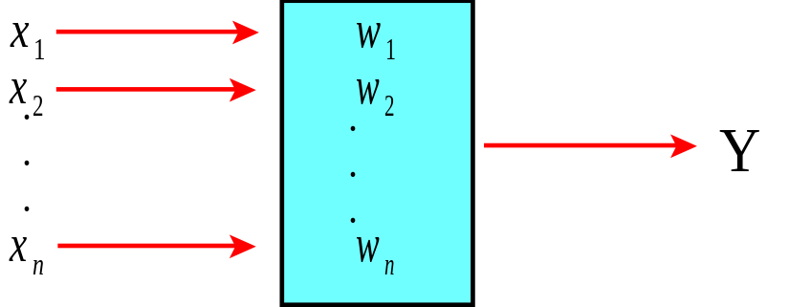
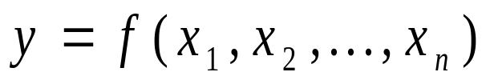
Structure of simple neuron
Assumptions:

Slide 5
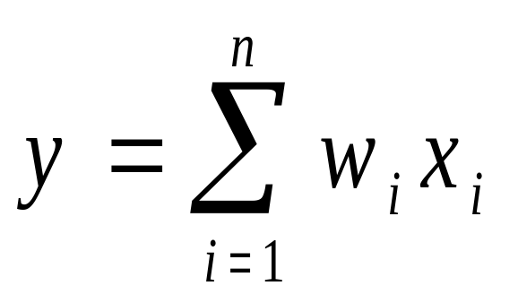
Output
The simplest way to calculate the oput from the neuron is to use the following linear function

Slide 6
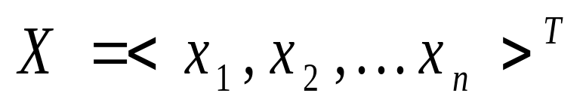
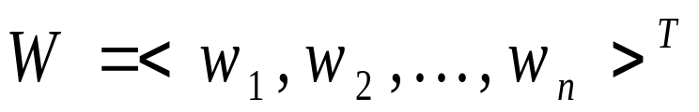
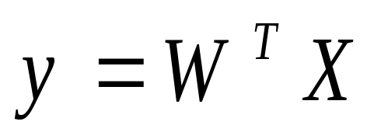
Structure of the simple neuron
Set of inputs and weights could be presented as the vectors.
So the output could be calculated as:

Slide 7
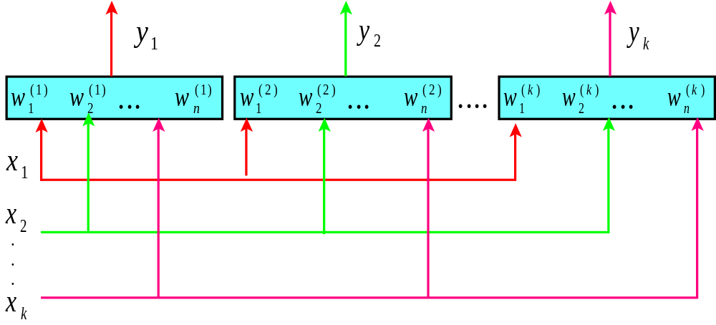
Neural network with one layer

Slide 8
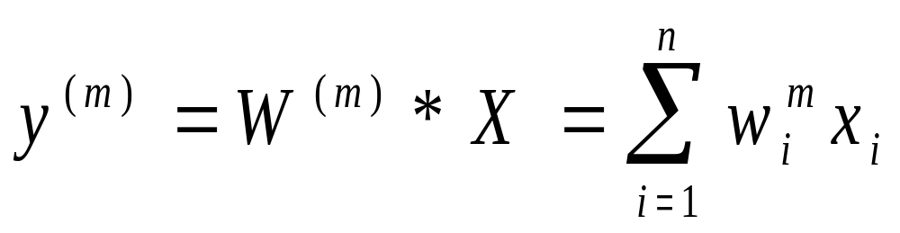
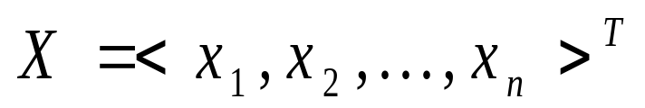
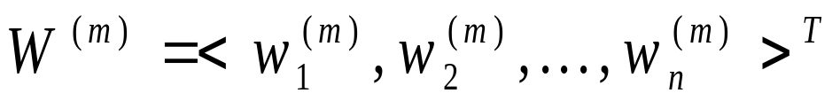
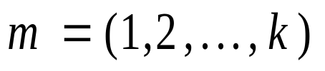
Neural network with one layer
The output from the one particular neuron could be calculated as:
where

Slide 9
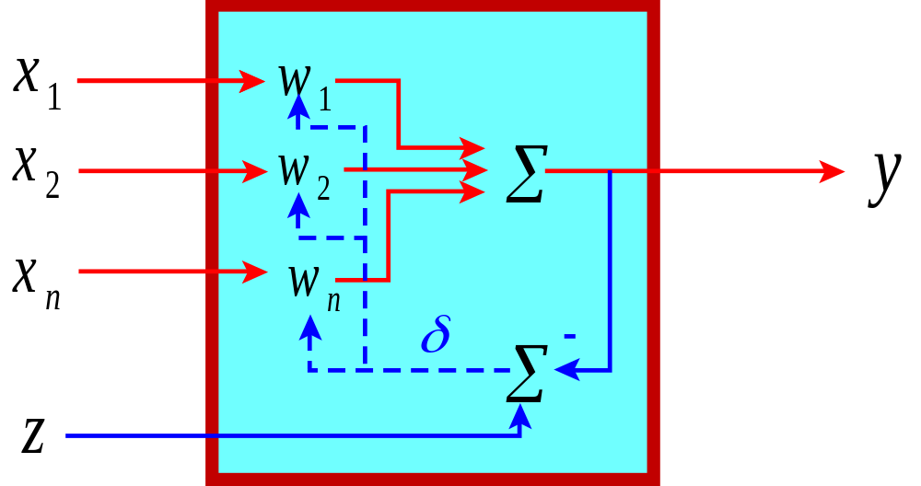
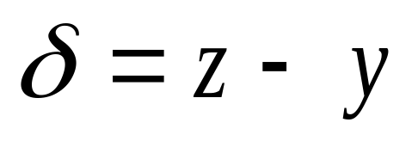
How the simple neuron is learning ?

Slide 10



How the simple neuron is learning ?
New vector of weight is calculated using the following function:
Where
W’ – new vector of neuron’s weghts
- Learning parameter

Slide 11
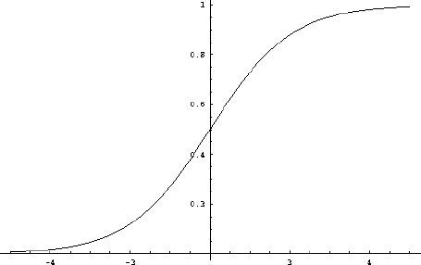
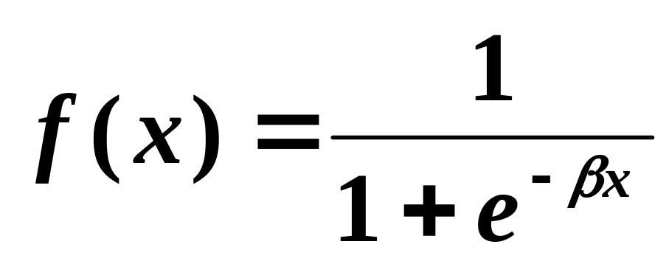
Sigmoid function
f(x)
x

Slide 12
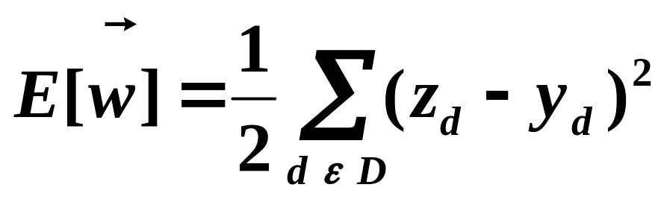
Sigmoid function
Learn w_{i}’s that minimize squared error
D = training data

Slide 13
Batch learning
Initialize each w_{i} to small random value
Repeat until termination:
  Δw_{i} = 0
  For each training example d do
  y_{d} ← f(Σ_{i} w_{i} x_{i,d})
  Δw_{i} ← Δw_{i} + η (z_{d} − y_{d}) y_{d} (1-y_{d}) x_{i,d}
  w_{i} ← w_{i} + Δw_{i}

Slide 14
Sequential learning
Initialize each w_{i} to small random value
Repeat until termination:
  For each training example d do
  Δw_{i} = 0
  y_{d} ← f(Σ_{i} w_{i} x_{i,d})
  Δw_{i} ← Δw_{i} + η (z_{d} − y_{d}) y_{d} (1-y_{d}) x_{i,d}
  w_{i} ← w_{i} + Δw_{i}

Slide 15
Example
How to organize your free time ?
Circumstances
Free time : a lot, some, a little, lack of time
Weather : beatiful, good, bad
Money : a lot, some, a little, lack of money
Company : there is, there isn’t
Time of the day: morning , late morning, evening, night
What to do: go to the restaurant, go to the concet hall, go for a walk, listen the lectures, read the book, go to sleep

Slide 16
Example
Inputs to the network :
IN 1 Free time
a lot
1
some
2
a little
3
lack of time
4

Slide 17
Example
Inputs to the network :
IN 2 : weather
Beatiful
1
Good
2
Bad
3

Slide 18
Example
Inputs to the network :
IN 3 Money
a lot
1
some
2
a little
3
lack of moeny
4

Slide 19
Example
Inputs to the network :
IN 4 Company
There is
1
There isn’t
2

Slide 20
Example
Inputs to the network :
IN 5 Money
a lot
1
some
2
a little
3
lack of moeny
4

Slide 21
Example
Output from the network :
OUT 1 What to do ?
Restaurant
1
Concert hall
3
Walking
4
Book
5
Sleeping
6

Slide 22
Example
Structure of the network:
5 inputs and 6 outputs
5 inputs and 1 output
Hidden layers
Number of neurons in hidden layers

